Slide 1
Team 4 Final Project
Brandon Gathright
Joseph Muir
Yukon Peng

Slide 2
Submitted Model
RandomForest (n_estimators=1000, max_depth=5)
Dataset:
1000 - Windows default binaries
500 - Vendor 64-bit binaries
500 - Vendor 32-bit binaries
250 - Initial malware samples for adversarial portion
250 - Our adversarial samples
500 - Most recent malwares uploaded in last week (malware bazar)

Slide 3
Feature Extraction - Summary
414 features in total extracted
14 header features
200 bi-gram byte features
100 bi-gram opcode features
100 tri-gram opcode features
n-gram: sequence of of n adjacent bytes within the binary file. Frequency is computed. This can help capture the semantics of each file.

Slide 4
Byte file
We run pe.get_data()
if pe.OPTIONAL_HEADER.SizeOfCode > maxBytes (50,000 for our test)
byte_file = pe.get_data(pe.OPTIONAL_HEADER.BaseOfCode, MAX_BYTES)
else:
byte_file = pe.get_data(pe.OPTIONAL_HEADER.BaseOfCode, pe.OPTIONAL_HEADER.SizeOfCode)

Slide 5
ASM file
We get the byte file
Disassemble into ASM using the dis library
Split by new lines to get each instruction line
Split each instruction line to get the opcode
return list of opcodes

Slide 6
Header feature - selection
Every static header feature from the PE file is being processed into a single feature vector
Selected top 14 most influential header features from the PE file were used for classification
We selected the features using the RandomForest (n_estimators=1000, max_depth=5) classifier

Slide 7
Header feature – 14 selected results
FILE_HEADER.MACHINE - target architecture for the file (e.g., Intel x86, AMD64, ARM).
FILE_HEADER.CHARACTERISTICS - 16-bit value that denotes different features and properties of the file. These features are defined using a bitwise OR combination of multiple constants that establish the traits of the executable file.
FILE_HEADER.SIZEOFOPTIONALHEADER: This field specifies the size of the optional header that immediately follows the file header.

Slide 8
Header feature – 14 selected results
OPTIONAL_HEADER.IMAGEBASE: This field specifies the preferred address of the first byte of the image when it is loaded into memory.
OPTIONAL_HEADER.MAJOROPERATINGSYSTEM: This field specifies the major version number of the operating system required to run the file.
OPTIONAL_HEADER.MAJORSUBSYSTEMVERSION: This field specifies the major version number of the subsystem required to run the file.
OPTIONAL_HEADER.DLLCHARACTERISTICS: This field specifies various attributes and characteristics of the file, such as whether it is a DLL or a driver.
OPTIONAL_HEADER.SUBSYSTEM: This field specifies the subsystem required to run the file, such as Windows or Console.

Slide 9
Header feature – 14 selected results
PE_SECTIONS.MAXENTROPY: This field represents the maximum entropy value of the binary sections of the PE file. Entropy is a measure of the randomness or unpredictability of data, and high entropy values can indicate that a section of the binary code may be obfuscated or encrypted.
PE_SECTIONS.MINENTROPY: This field represents the minimum entropy value of the binary sections of the PE file.
PE_SECTIONS.MEANENTROPY: This field represents the mean entropy value of the binary sections of the PE file.
RESOURCES.MAXENTROPY: This field represents the maximum entropy value of the resources section of the PE file.
RESOURCES.MINENTROPY: This field represents the minimum entropy value of the resources section of the PE file.
VS_VERSIONINFO.Length: This field specifies the length, in bytes, of the VS_VERSIONINFO resource.

Slide 10
Bi-gram byte feature - selection
Unique set of every bi-gram byte encountered in all samples
Selected top 200 most influential bi-gram bytes from the unique set
We selected the features using the RandomForest (n_estimators=1000, max_depth=5) classifier
One-hot encoded each of the sample with the presence of each selected bi-gram byte

Slide 11
Bi-gram opcode feature - selection
Unique set of every bi-gram opcode encountered in all samples
Selected top 100 most influential bi-gram opcodes from the unique set
We selected the features using the RandomForest (n_estimators=1000, max_depth=5) classifier
One-hot encoded each of the sample with the presence of each selected bi-gram opcodes

Slide 12
Tri-gram opcode feature - selection
Unique set of every tri-gram opcode encountered in all samples
Selected top 100 most influential bi-gram opcodes from the unique set
We selected the features using the RandomForest (n_estimators=1000, max_depth=5) classifier
One-hot encoded each of the sample with the presence of each selected tri-gram opcodes

Slide 13
Tri-gram opcode feature - selection
Unique set of every tri-gram opcode encountered in all samples
Selected top 100 most influential bi-gram opcodes from the unique set
We selected the features using the RandomForest (n_estimators=1000, max_depth=5) classifier
One-hot encoded each of the sample with the presence of each selected tri-gram opcodes

Slide 14
Weakness
Any time the header feature is not there we have it encoded as 0
We don’t have a pipeline for checking different features yet like some of the other teams
We don’t have the confidence interval like other team for more explainable results
Small dataset not representative of real-world samples
We are only analyzing the first 50,000 bytes of the file

Slide 15
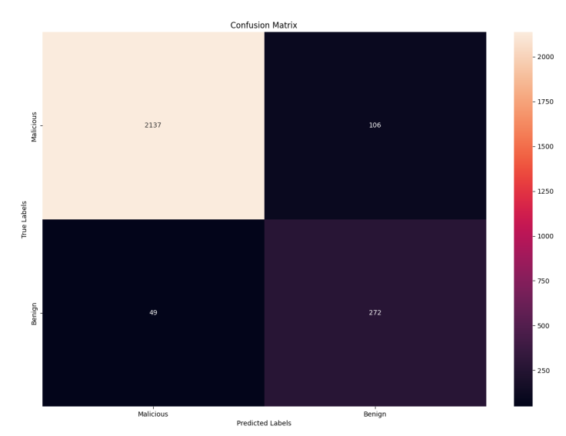
Result

Slide 16
Attack

Slide 17
Motivation
Develop a novel method of generating adversarial samples that bypass ML-based static antiviruses from other teams.
Must take any Windows virus and modify it to evade detection
Must retain functionality.

Slide 18
Solution
Comparing all papers covering in this class, Dr. Botacin’s method proved to yield the highest evasion rates.
We decided to take the existing example on Github and augment it with improvements.

Slide 19
Baseline Attack
Combined Dr. Botacin’s filesystem.exe and inmemory.dll droppers into a single dropper that:
Compiled into an executable
Contained a single resource
XOR decrypted the resource
Base64 decoded the resource
Wrote the resource to file
Launched the resource
Dynamically loaded 90% of APIs
Encoded strings as int arrays
Mimicked the NTDLL.dll

Slide 20
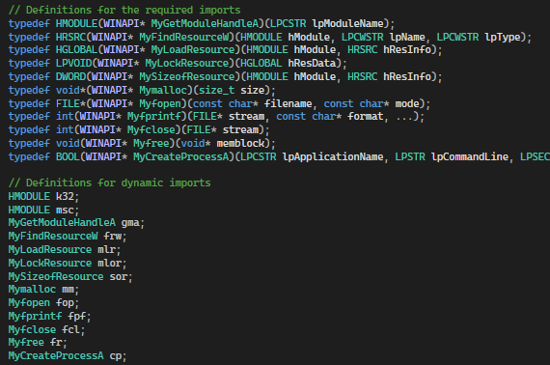
Baseline Attack Visualization
Dynamic APIs from inmemory.dll

Slide 21
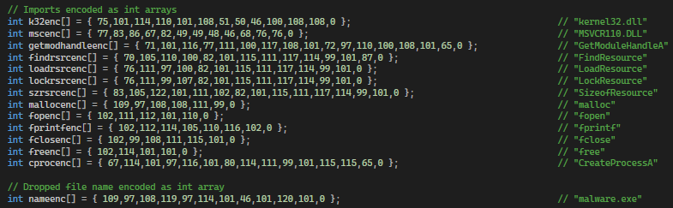
Baseline Attack Visualization
Encoded API strings from inmemory.dll

Slide 22
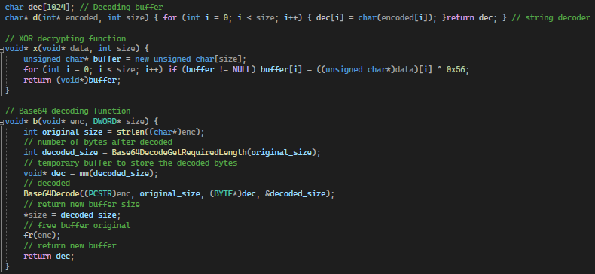
Baseline Attack Visualization
Int array decoder, XOR decrypter, and Base64 decoder from filesystem.exe

Slide 23
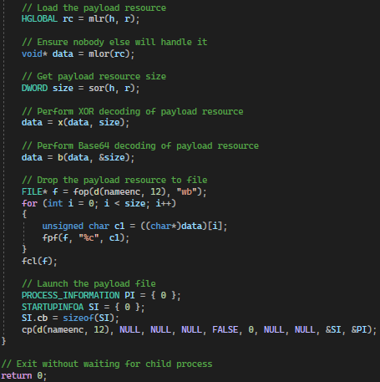
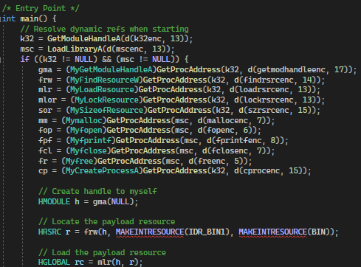
Baseline Attack Visualization
Main program combined from filesystem.exe and inmemory.dll

Slide 24
Attack v1 Summary
A list of improvements added:
Removed all remaining but 3 static APIs from original attack
GetModuleHandleA
GetProcAddress
LoadLibraryA
Replaced original handle reference to Kernel32.dll
Further encrypted the int arrays by applying ROT1
Implemented manual Base64 decoding

Slide 25
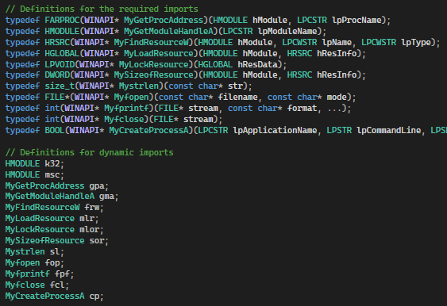
Attack v1 Visualization
Added dynamic APIs for:
GetProcAddress
Strlen

Slide 26
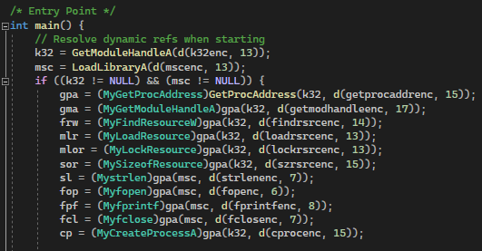
Attack v1 Visualization
Changed handle to kernel32.dll from LoadLIbraryA to GetModuleHandleA
Loaded dynamic APIs for:
GetProcAddress
Strlen

Slide 27
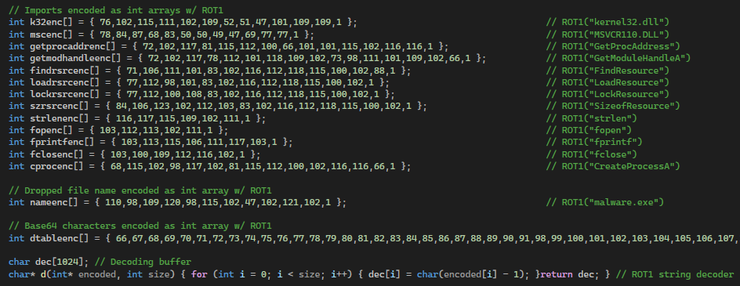
Attack v1 Visualization
Encoded all strings with ROT1
Added encoded strings for:
Base64 decoding table
GetProcAddress
Strlen

Slide 28
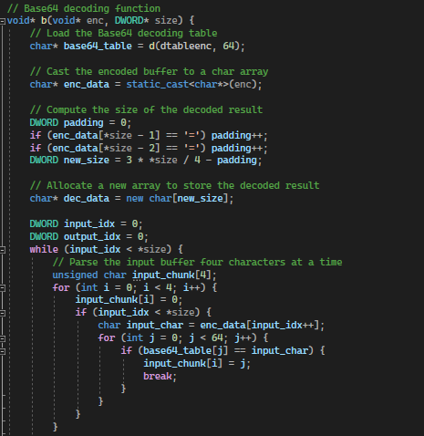
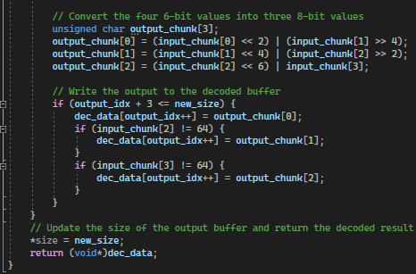
Attack v1 Visualization
Implemented manual Base64 decoder

Slide 29
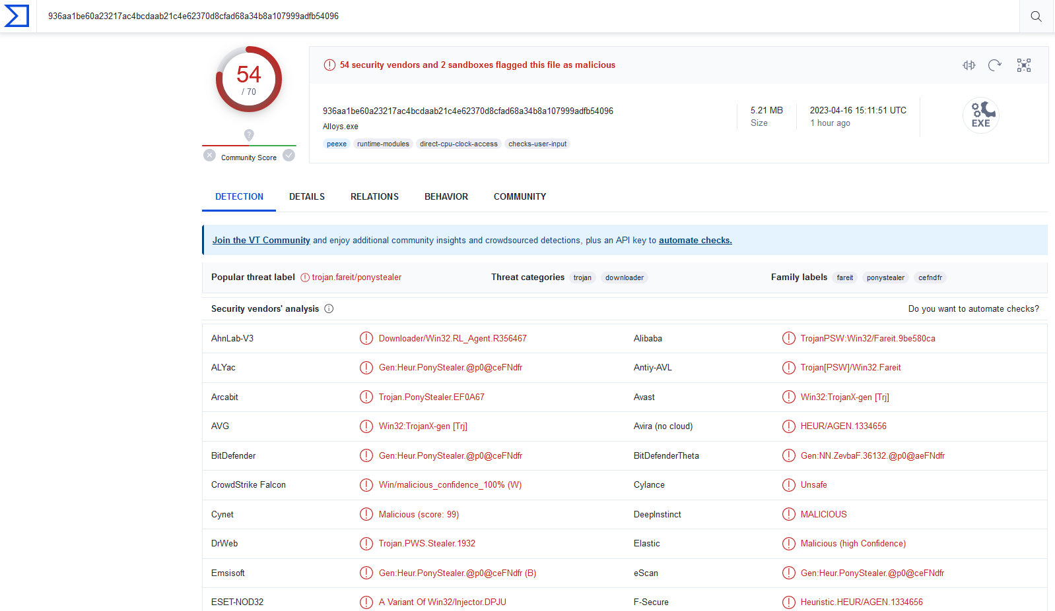
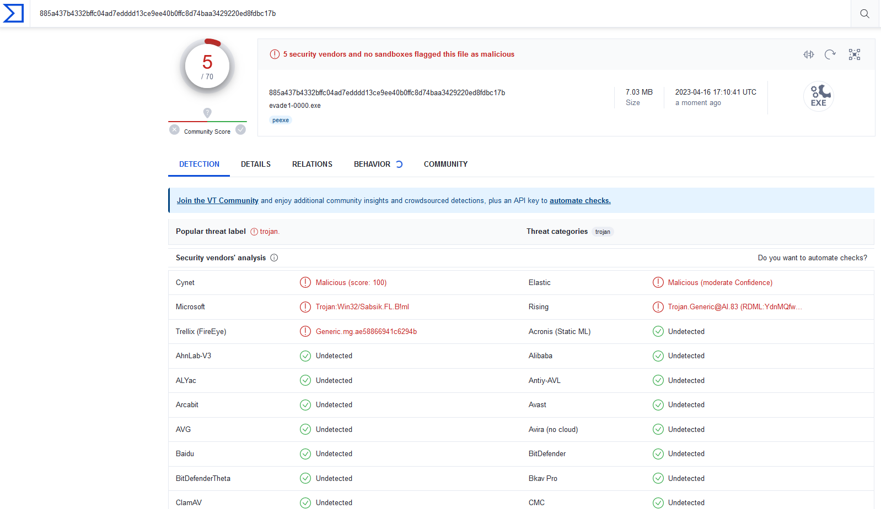
Attack v1 Results
VirusTotal of Evade1-0000 before and after
Before
After

Slide 30
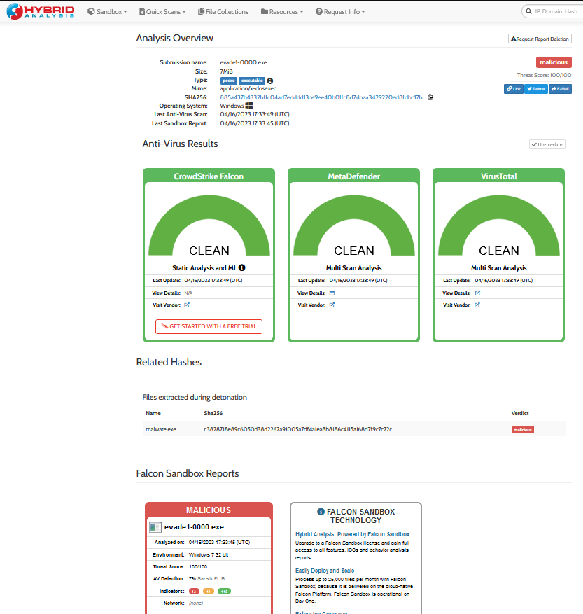
Attack v1 Results
Hybrid Analysis

Slide 31
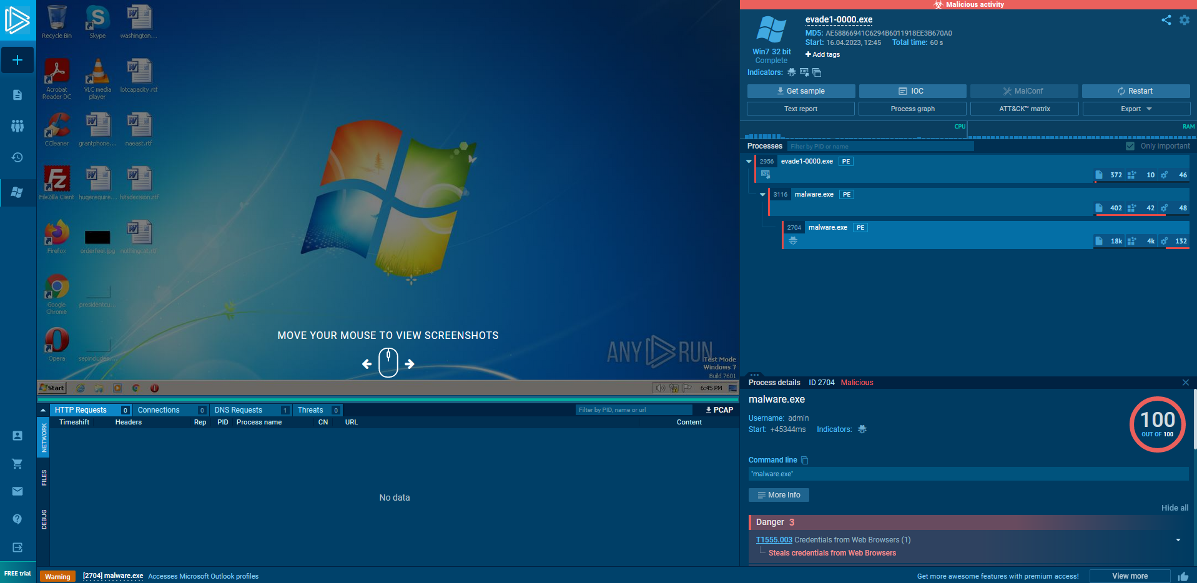
Attack v1 Results
Sandbox Execution

Slide 32
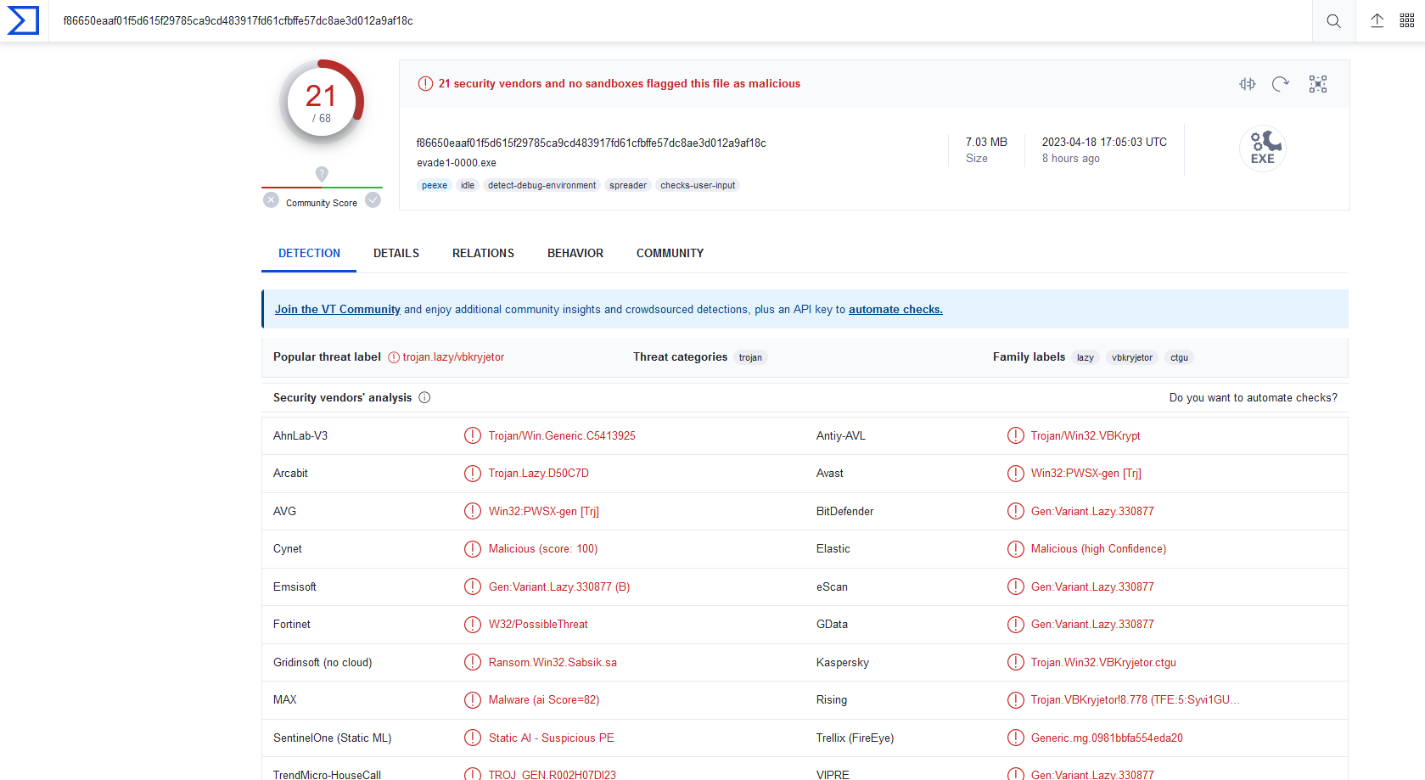
Attack v1 Additional Note
Changing nothing and running Evade1-0000 24 hours later
Indicates industry information sharing and quick retrain

Slide 33
Attack v2 Summary
A list of improvements added:
Manually parsed Kernel32.dll to find GetProcAddress
Added dynamic reference for LoadLibraryA
Implemented manual computation of int array length
Implemented manual conversion of GETINTRESOURCE
Added error checking at each stage of dynamic loading

Slide 34
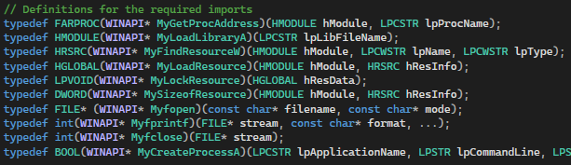
Attack v2 Visualization
Replaced dynamic API for GetModuleHandleA with LoadLibraryA
Removed dynamic API strlen

Slide 35
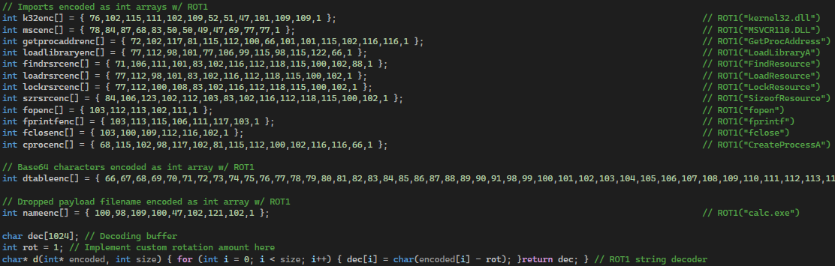
Attack v2 Visualization
Replaced encoded string for GetModuleHandleA with LoadLibraryA
Removed encoded string for strlen

Slide 36
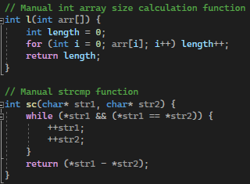
Attack v2 Visualization
Implemented manual int array size calculation
Implemented manual strcmp

Slide 37
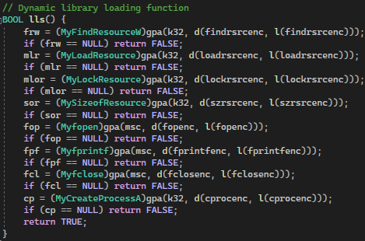
Attack v2 Visualization
Removed dynamic loading for GetModuleHandleA and strlen
Moved dynamic loading into encapsulated function

Slide 38
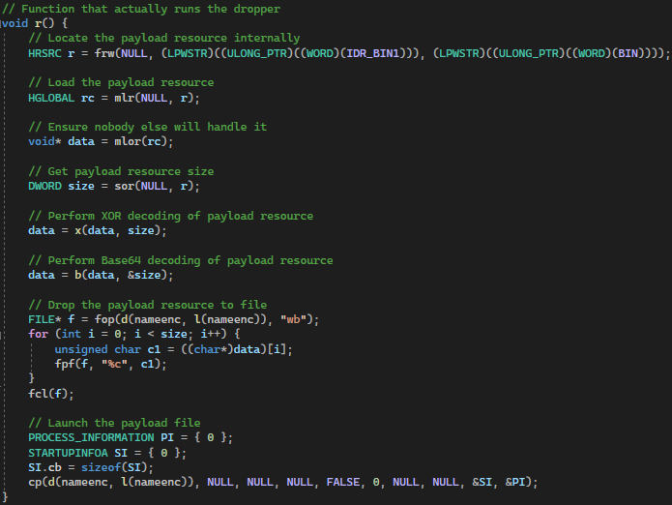
Attack v2 Visualization
Moved actual dropper into encapsulated function

Slide 39
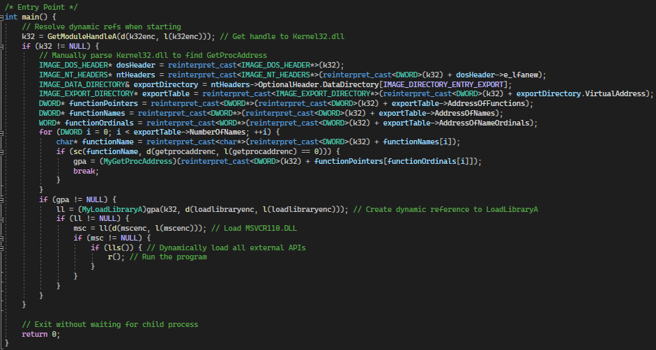
Attack v2 Visualization
Simplified main by calling encapsulated functions
Replaced handle to ke32 with LoadLibraryA
Manually parsed k32 to find base address for GetProcAddress

Slide 40
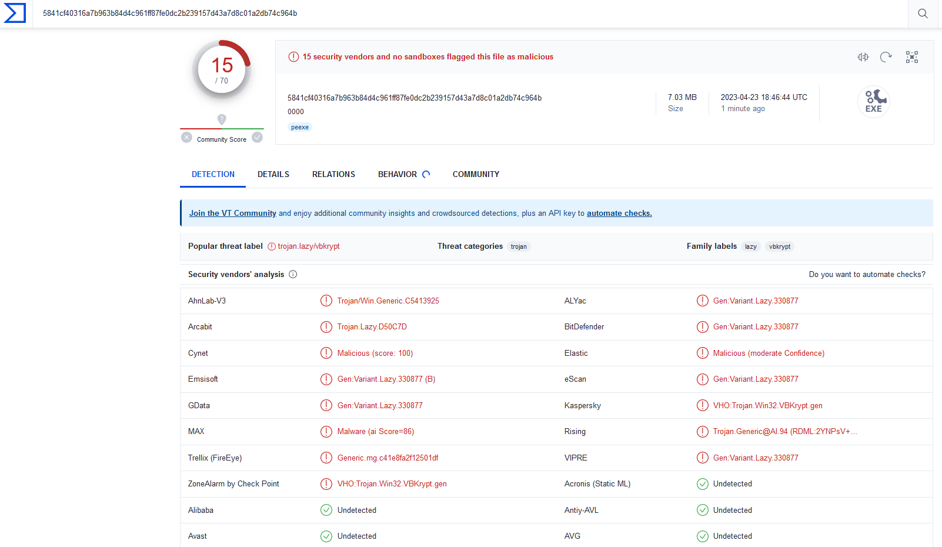
Attack v2 Results
VirusTotal of Evade1-0000 (dropped from 21 to 15)

Slide 41
Attack v3 Summary
While waiting for results from round 1, attempt to bypass remaining VT antiviruses using dynamic analysis evasion
A list of improvements added:
Added 60 second wait timer before execution
Added sandbox environment detection
Added debugger detection

Slide 42
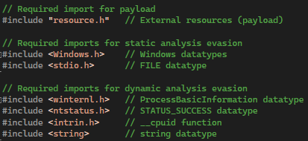
Attack v3 Visualization
Added new static imports for dynamic analysis evasion

Slide 43
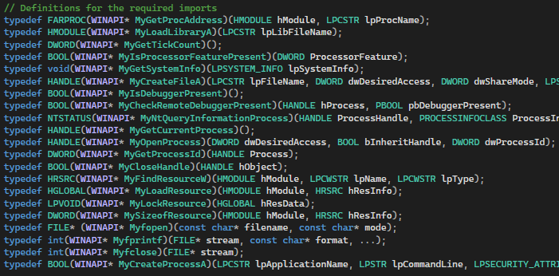
Attack v3 Visualization
Added additional dynamic imports for dynamic analysis evasion:
GetTickCount
IsProcessorFeaturePresent
GetSystemInfo
CreateFileA
IsDebuggerPresent
CheckRemoteDebuggerPresent
NtQueryInformationrocess
GetCurrentProcess
OpenProcess
GetProcessId
CloseHandle

Slide 44
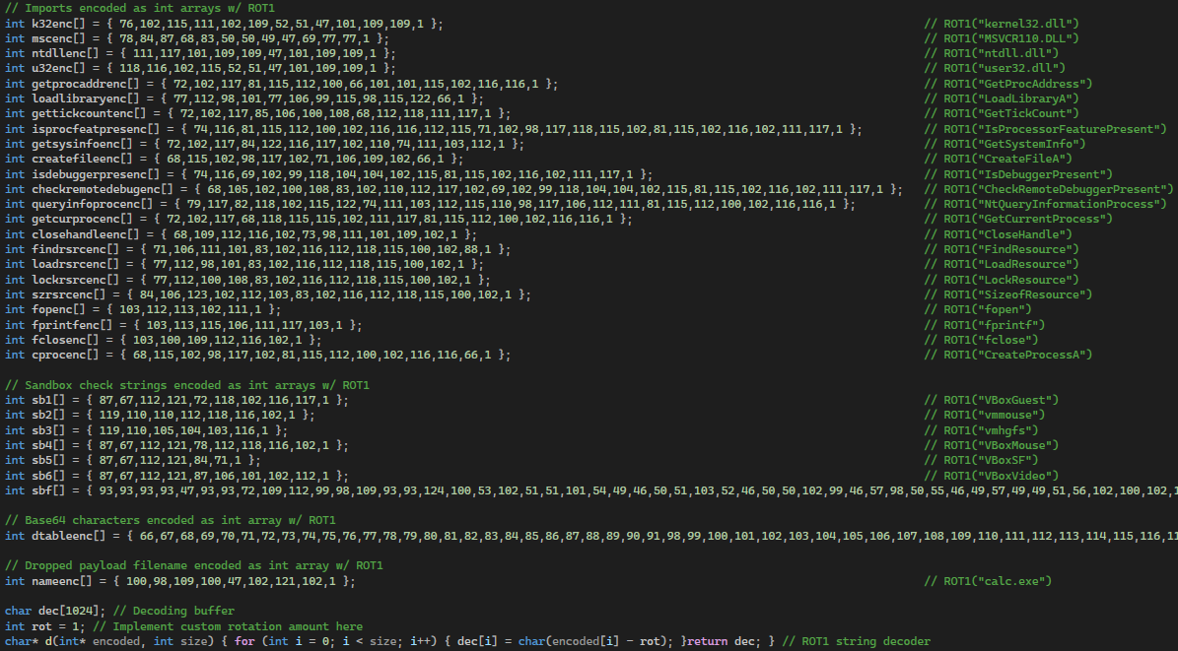
Attack v3 Visualization
Added additional encoded API strings for dynamic analysis evasion:
GetTickCount
IsProcessorFeaturePresent
GetSystemInfo
CreateFileA
IsDebuggerPresent
CheckRemoteDebuggerPresent
NtQueryInformationrocess
GetCurrentProcess
OpenProcess
GetProcessId
CloseHandle
Virtual machine drivers
VBoxGuest
Vmmouse
Vmhgfs
VBoxMouse
VBoxSF
VBoxVideo

Slide 45
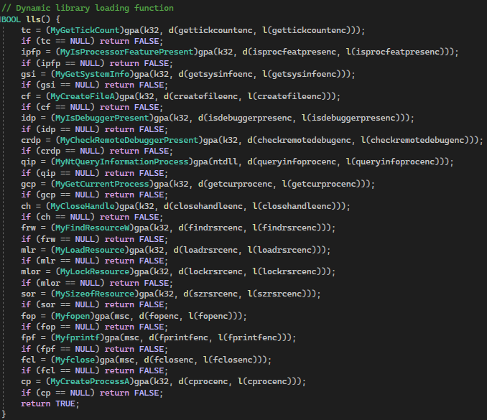
Attack v3 Visualization
Loading of new dynamic APIs for dynamic analysis evasion

Slide 46
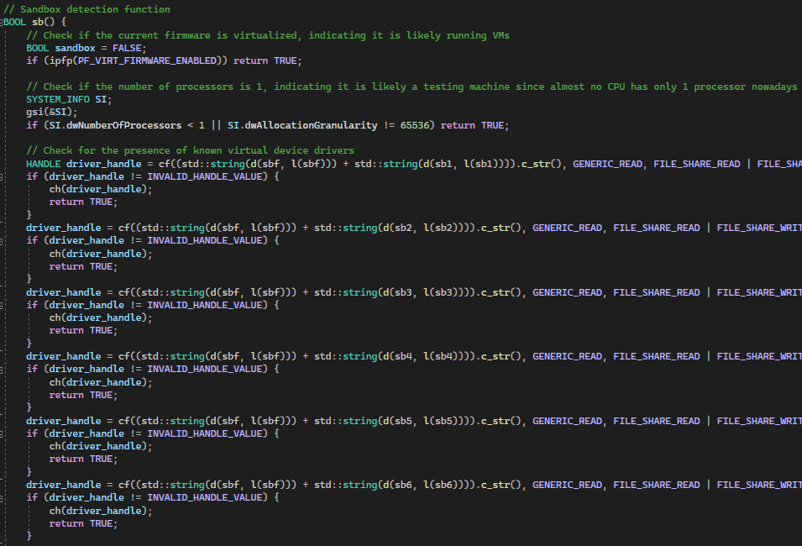
Attack v3 Visualization
Sandbox environment detection for dynamic analysis evasion (Ch1-3)
Check 1
If virtualization enabled
Check 2
If processor count == 1
Check 3
If any common VM driver present

Slide 47
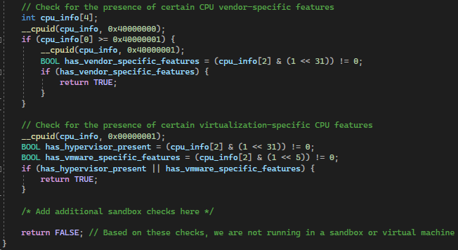
Attack v3 Visualization
Sandbox environment detection for dynamic analysis evasion (Ch4-5)
Check 4
If vendor virtualization flags set in CPU
Check 5
If standard virtualization flags are set in CPU

Slide 48
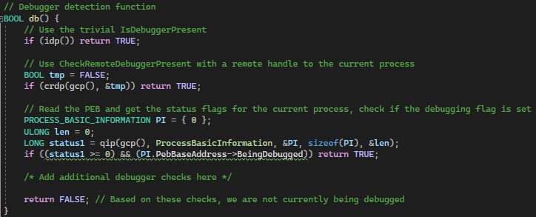
Attack v3 Visualization
Debugger detection for dynamic analysis evasion
Check 1
IsDebuggerPresent
Check 2
CheckRemoteDebuggerPresent w/ handle to current process
Check 3
Traverse PEB linked-list and fund process block for current process and check if debugger is currently attached

Slide 49
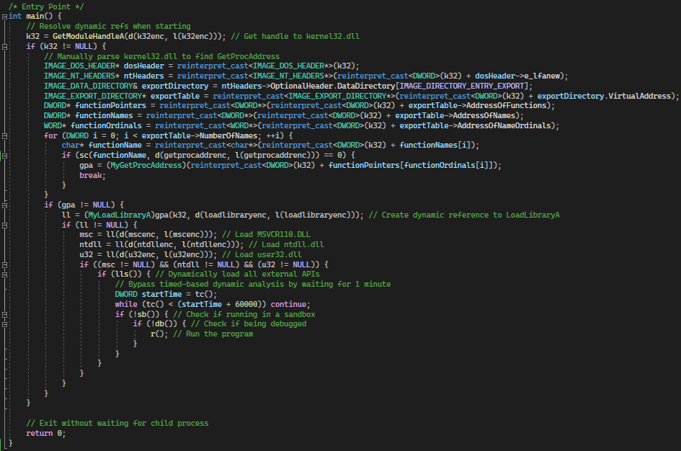
Attack v3 Visualization
Modified main to run 1 minute wait, sandbox detection, and debugger detection before running the dropper.

Slide 50
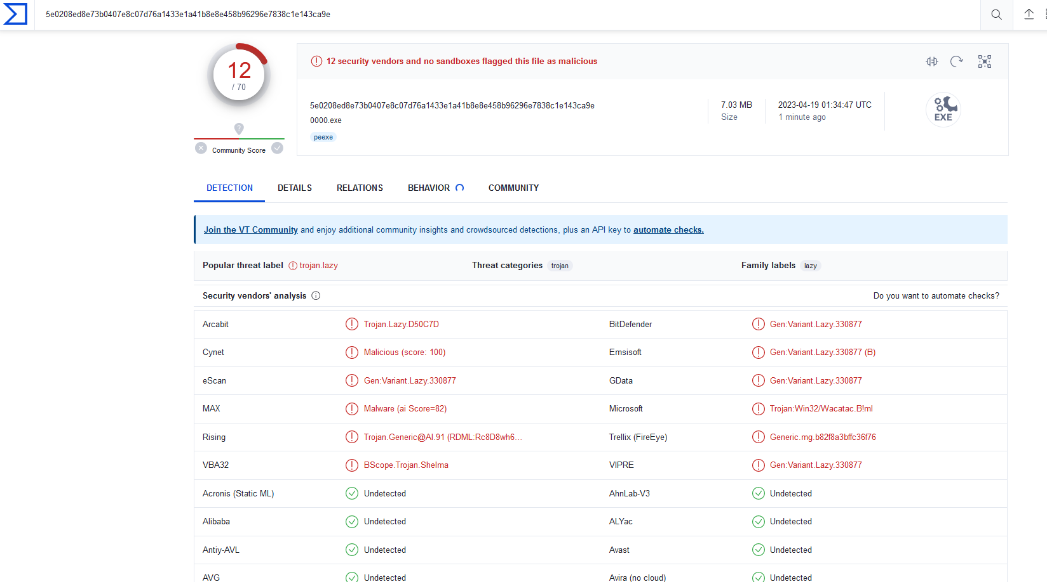
Attack v3 Results
VirusTotal of Evade1-0000 (dropped from 15 to 12)

Slide 51
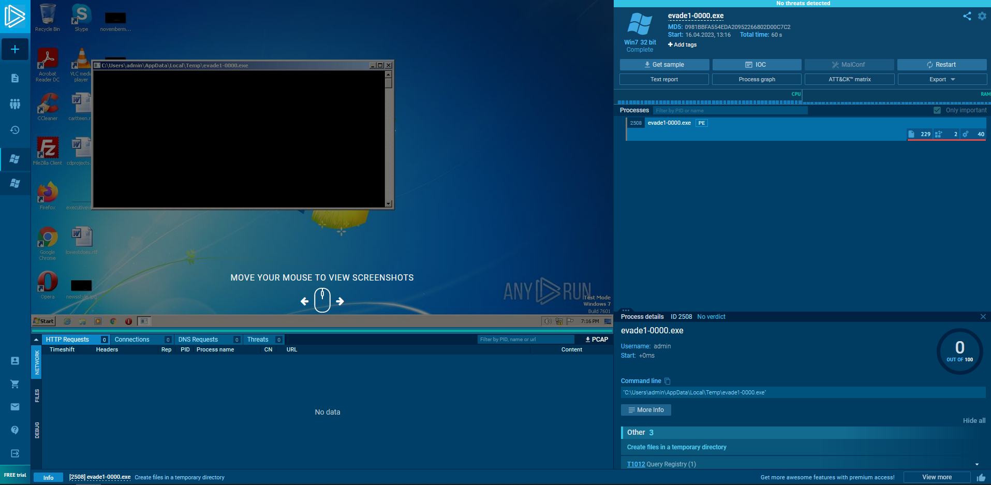
Attack v3 Results
Sandbox Execution (bypasses sandbox analysis)

Slide 52
Attack v4 Summary
After receiving results from round 1
Noticed that not a single sample evaded Yasir’s model
Found invalid PE handling in Yasir’s model
Exploited Yasir’s model to force a benign classification
A list of improvements added:
Created benign stager that runs after compilation and before execution

Slide 53
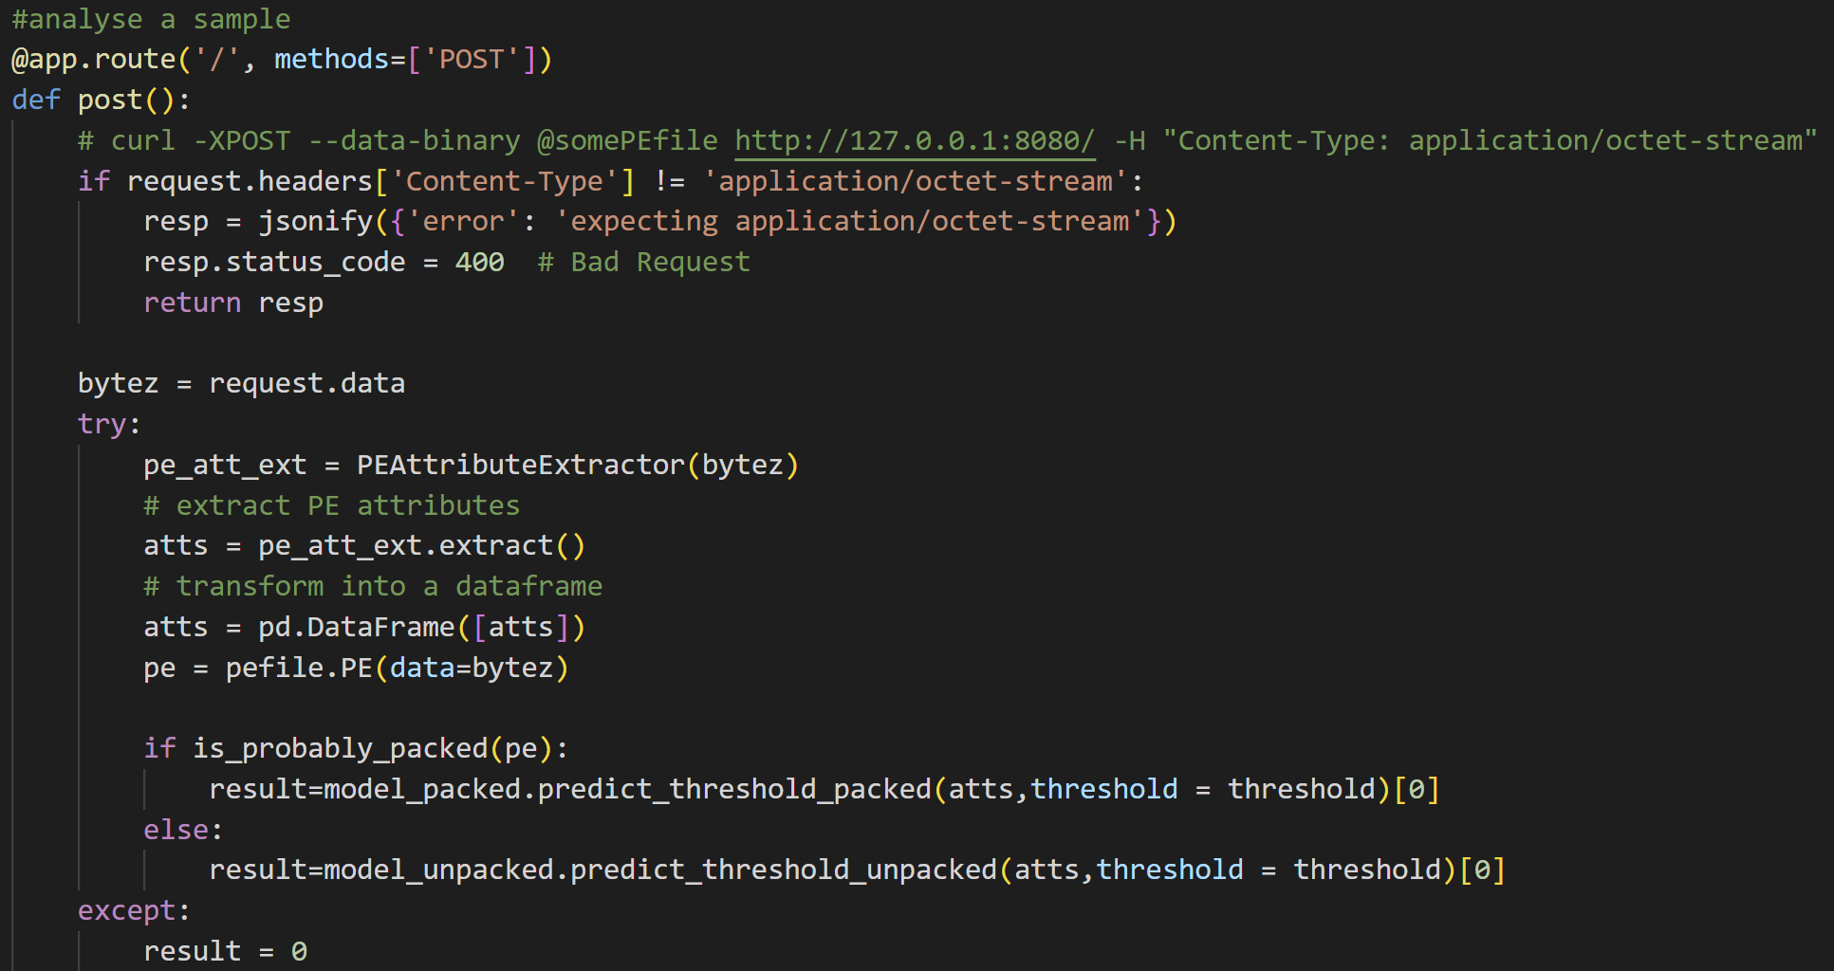
Attack v4 Visualization
Vulnerability in Yasir’s model (all errors return benign)

Slide 54
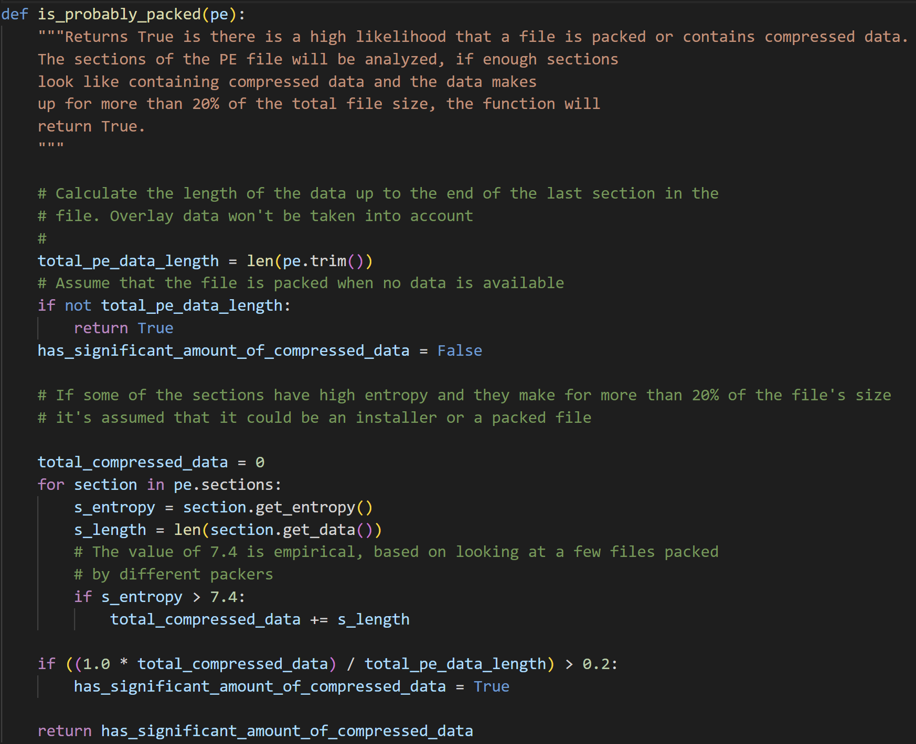
Attack v4 Visualization
Vulnerability in Yasir’s model (should use hasattr before accessing pe.sections)

Slide 55
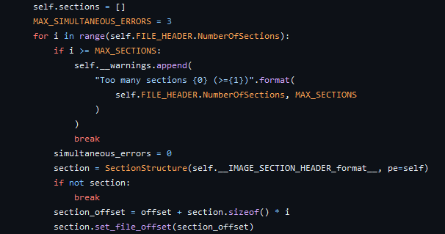
Attack v4 Visualization
How the Pefile module gathers sections when calling pe.sections
Directly uses NumberOfSections as count
Either set NumberOfSections to 0 or greater than MAX_SECTIONS

Slide 56
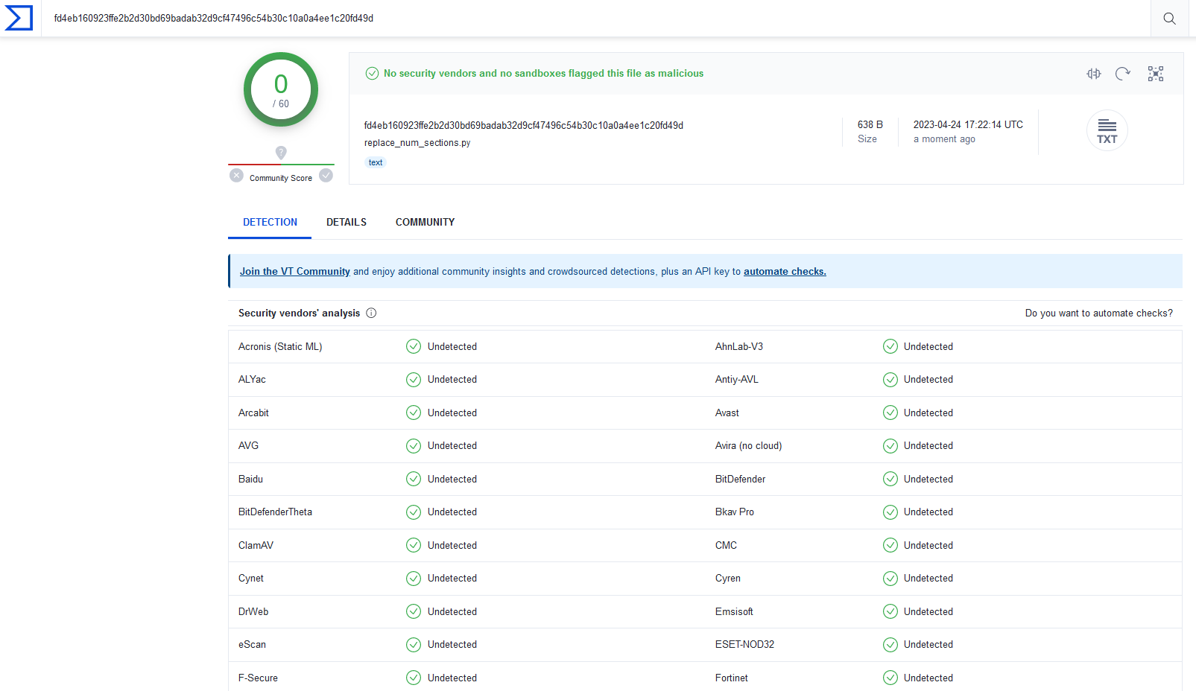
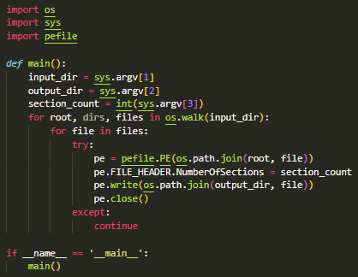
Attack v4 Visualization
Stager created to modify each executable NumberOfSections
Classified as benign

Slide 57
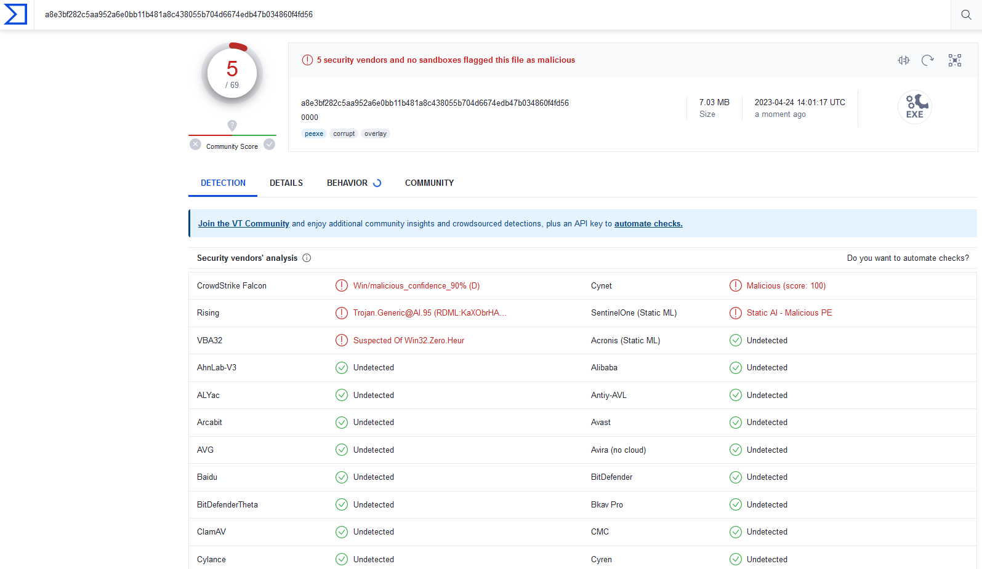
Attack v4 Results
VirusTotal of Evade1-0000 (drops from 12 to 5, overall 54 to 5)

Slide 58
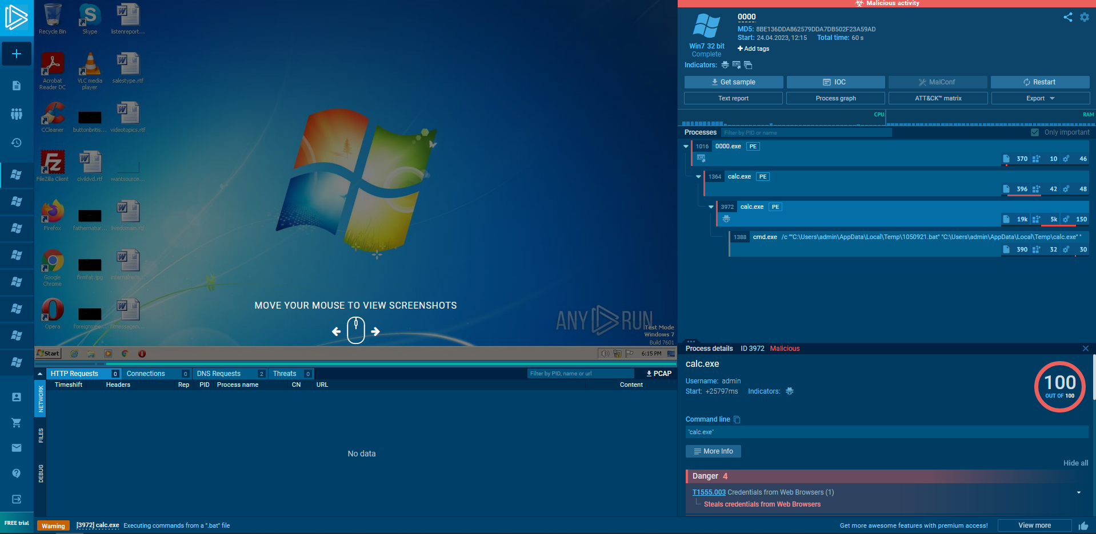
Attack v4 Results
Sandbox Execution (stager executed on sandbox machine before running dropper)

Slide 59
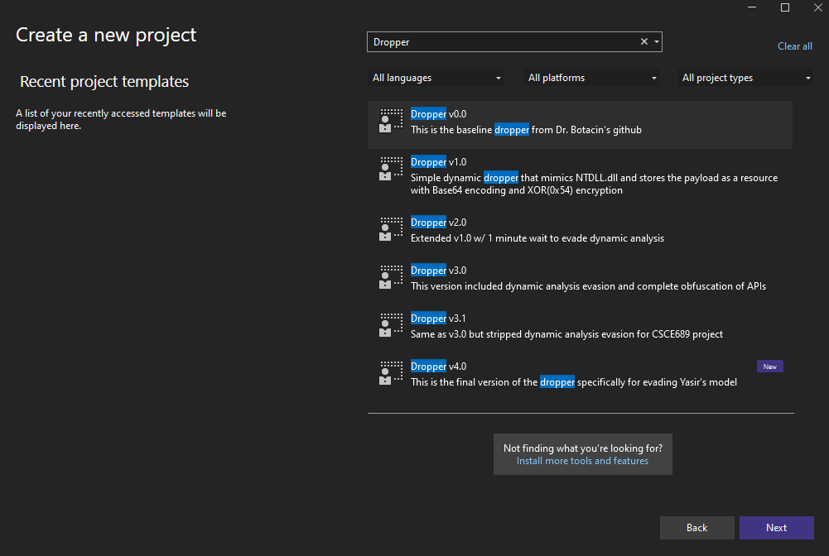
Additional Tools – VS Ease of Use
Create VS templates for quick project creation

Slide 60
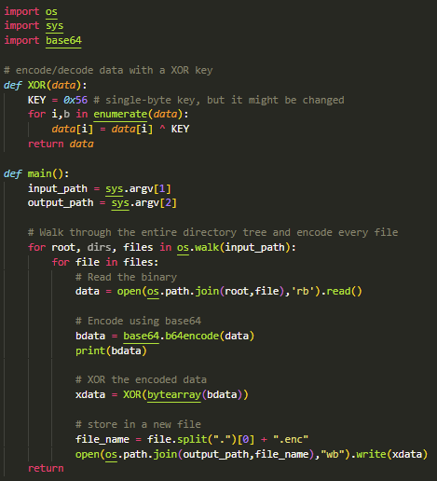
Additional Tools – Creating Encoded Resources
Program to perform XOR encryption and Base64 encoding of files

Slide 61
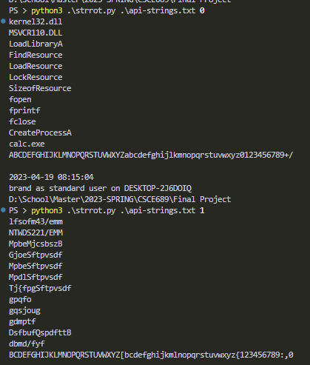
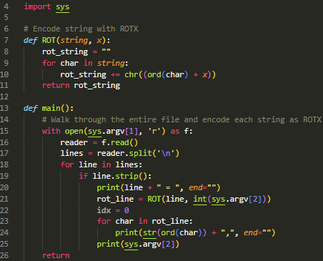
Additional Tools – Creating ROT1 int Arrays
Program to perform ROTX encoding of API strings

Slide 62
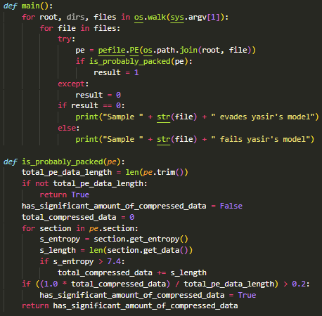
Additional Tools – Testing Yasir’s Vulnerability
Program to test if samples exploit Yasir’s model

Slide 63
Future Work
Embed dropper in different file type
Python executable (auto-py-to-exe) [1] [2]
Excell plugin (XLL) [1] [2]
Incorporate different method to launch process
Inject into own process then return execution after [1]
Doppelgӓng another legitimate process [1]
Add more sandbox and debugger detection methods
Wait to execute until after reboot [1]
Lock kernel32.dll to prevent analysis programs from using [2]
Self patch NumberOfSections to remove stager and still bypass is_packed test
Create program with 1 section of assembly instructions for updating NumberOfSections and BaseOfCode, then restart the executable

